Slide 1
Centre for Aerospace and Defence Laws (CADL)
M.A. (Security & Defence Laws)
Semester I (Batch 2019-21)
MODULE-I: DEFENCE TECHNOLOGIES AND DEFENCE APPLICATIONS
Lt Gen AV Subramanian (Retd) AVSM, VSM
15 Sep 19

Slide 2
Schedule
Session I: 9.00 – 11.00 a.m.: Defence Technology and its Applications: Defence Technology and Defence Laws:
Session II: 2 p.m. - 4 p.m: Defence Technology and Defence Laws : Defence Technology and its Applications

Slide 3
Module I : Content
SPECTRUM OF CONFLICT
BATTLEFIELD TRANSPARENCY
COMMUNICATION SYSTEMS
ROCKET AND MISSILE SYSTEMS
AIRCRAFT
UAV
LAND SYSTEMS
NAVAL SYSTEMS
DIRECTED ENERGY WEAPONS
FOURTH FRONT (SPACE): FIFTH (CYBER)
MILITARY INTELLIGENCE
NON-LETHAL WEAPONS
AUTONOMOUS WEAPONS SYSTEM (AWS)

Slide 4
Agenda: Session I
Spectrum of Conflict
  Dominate the full range of military operations, from humanitarian assistance to conventional warfare
Technological superiority
Indian Defence Technology Base

Slide 5
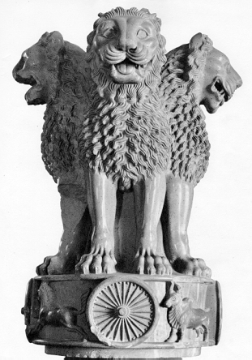

“I have three visions for India”
My first vision is that of freedom. I believe that India got its first vision in 1857.
My second vision for India is development. It is time we see ourselves as a developed nation, self reliant and self assured.
I have a third vision. That India must stand up to the world. Only strength respects strength.”
“The loftier the building, the deeper the foundation must be laid.”
—Thomas Kempis
Notes:
1857 Is the Sepoy Mutiny, where the people of India gathered courage to ask for their rightful Freedom.
Liberty comes with its responsibilities. Liberty is preserved by strength, and the strength is derived from development.
Strength also means Security and hence the decisions that influence the National Security are one of the hardest decisions to make for any national leader.

Slide 6




DYNAMIC INTERNATIONAL SYSTEMS IN A GLOBALISED WORLD
MILITARY
DIPLOMATIC
TECHNOLOGY
ECONOMIC
Notes:
Nations assert their interests through many mediums. The technology as a medium of national assertion of its influence is becoming evident. The sanctions either as nations or collectively as United Nations is increasingly centered on technology. The aftermath of the Pokran II is fresh in our memories.

Slide 7
Levels of Economic Development
Less-Developed Country
Developing Country
Industrialized Country
Low literacy
Limited technology
Agricultural or mining economy
Improving literacy
Improving technology
Decreasing dependence on agriculture or mining
High literacy
Modern technology
Industrial economy
Notes:
The spectrum of Nations can be characterized in three groups, and the gradation of technology in this type of gradation is obvious.

Slide 8
COUNTRY’S CONCERN
US has strong, even unreserved, support from American citizens for a powerful defence system capable of deflecting any actual or potential threats by means of technological superiority in all areas. United States’ objective is overall technological superiority.
India had to contend with societies that are more concerned with social welfare than military threats, a fact reflected in the budget priorities. Government is taking steps to develop a harmonised slant to promote infusion of indigenous solutions.
Notes:
The contrast is obvious. This can be explained by the measure of level of development. The shift is an indication of the of this level.

Slide 9
US DoD Policy on Technology
A valuable, limited national security resource
Protected and invested in pursuit of national security objectives
International trade is key to strong U.S. industrial base
Export controls to minimally interfere with legitimate trade
Notes:
Technological excellence is a constant theme in American society. The United States’ objective is overall technological superiority and it pursues an extremely proactive and rigorous policy to achieve its goal. There is consensus that the military should have the right, and even the duty, to promote technology on a large scale. In Europe, the military do not have the same room for manoeuvre. In view of reduced budgets for defence R&D, the trend is more towards increased specialisation in military R&T, accompanied by a stronger requirement to set priorities.
ON A DOD LEVEL:
DoD Policy: It will be controlled and protected. DoD Directive 2040.2, Intl. Transfers of Technology, Goods, Services, and Munitions.
But because intl. Trade is important to a strong U.S. defense industrial base, the DoD shall apply export controls in a way that minimally interferes with legitimate trade and scientific endeavor.

Slide 10
USA Model
Domestic Source Restrictions in USA
Homeland Security
Defence Trade Offsets
Defense Industrial Base Studies
Network Security Issues
  Network Security Agreements (NSAs)
  Personnel Screening
  Outsourcing
  Visitation
  Routing
  Security Audits
Industrial Security Review by DSS
Special Security Agreements/Security Control Agreements (“SSA/SCA”)
Committee on Foreign Investment in the United States (CFIUS)
Notes:
In the US Model there are many policy framework to encourage Technology Security. Let me highlight a few systems to give a bird’s eye view of the systems in place.
Federal regulations and DoD guidance recognize the need to restrict competition to domestic sources to address national security concerns. The Federal Acquisition Regulation permits competition to be limited to meet mobilisation base or other national security needs. DoD’s Handbook for Assessing Defense Industrial Capabilities provides guidance for determining such restrictions. Restrictions are used to limit the acquisition of items to domestic sources and prohibit the procurement of foreign-manufactured products when competition needs to be restricted to support national security needs. This guidance also indicates that limitations on foreign sources may be needed to avoid dependence on a politically unreliable foreign supplier or protect technologies and products that are classified because they offer unique war-fighting superiority, or can enable foreign governments to develop countermeasures that could undermine the effectiveness of U.S. systems. Competition may also be restricted to meet mobilisation base needs. DoD’s planning guidance reflects the changes in military missions and requirements that have occurred since the end of the Cold War.
Special Security Agreements/Security Control Agreements (“SSA/SCA”)
Used in cases in which a foreign person owns or controls a U.S. company. Although companies operating under SSAs may have access to classified information in connection with their performance of classified contracts, they may access “proscribed information” only if they obtain a special DoD authorization following a National Interest Determination (“NID”). In order to obtain a NID, a company must present “compelling evidence” that the release of proscribed information “advances the national security interests of the United States.” An SCA is appropriate where a company is not under foreign control, but has representatives of a foreign investor on its board of directors. They are somewhat less restrictive than SSAs.
Committee on Foreign Investment in the United States (CFIUS).
Exon-Florio legislation authorises the President to suspend or prohibit foreign acquisitions, mergers, or takeovers of U.S. companies when there is credible evidence that a foreign controlling interest might threaten national security and other legislation cannot provide adequate protection. The legislative provisions are implemented by the interagency group, the Committee on Foreign Investment in the United States (CFIUS).

Slide 11
Technology Security Initiatives of China
Administrative action
Legal innovation
Increased support for research and development.
Technology policy based on promotion own technical standards
Notes:
In recent years, through administrative action, legal innovation, and increased support for research and development, China has been actively developing a new technology policy based on the promotion of its own technical standards. These activities impinge upon business decisions and raise questions about China’s commitment to honor its World Trade Organization (WTO) obligations, and are thus attracting increasing attention from foreign business leaders and government officials. The origins and motivations for China’s standards strategy, are to be placed it in the context of China’s accession to the WTO, and the operation of China’s new standards regime, with particular reference to standards for wireless devices and software.
In anticipation of accession to the WTO, Chinese leaders came to realise that the technological challenges ahead would intensify, while at the same time the more traditional measures of protection for its economy would have to be sacrificed. WTO accession would also require a significant re-organisation and modernization of its national standards system. In 2001 and 2002 China thus began to reform its standards regime with an eye toward building standard setting into its national research and development programs as a priority objective. This has now resulted in a system in which policy purposes for the standards regime — expressed through laws, administrative directives, and policy statements — are increasingly integrated with a research and development (R&D) network characterized by a strong commercial orientation, one involving a proliferation of high-technology start-up companies linked to government research institutes and universities, and a notable expansion of industrial research expenditures.

Slide 12
Defence Economy Model
Civil military integration - sophisticated defence economy stands on sophisticated economy-wide supply chain.
There is nothing more costly to the Nation than cheap Armed Forces- Carl Vinson
Defence Economy
Dual use economy
High-tech civilian sector
Low tech sector

Slide 13
Continuum of Operations
Exercises
Port Visits
Security Assistance
Civic Assistance
Freedom of Navigation and Overflight
Arms Control
Anti-terrorism
Aid to Civil Authorities
Humanitarian Assistance
Disaster Relief
L
I
K
E
L
I
H
O
O
D
Noncombatant Evacuation (Permissive)
Peacekeeping
Force Demonstration
Counterdrug Ops
Recovery Ops
Intervention to neutralise support to Insurgency
Protection of Shipping Routes
Enforcing Exclusive Economic Zones
Intercept Ops
Peace Enforcement
Counter-terrorism
Noncombatant Evacuation (Hostile)
Low Intensity Conflict
Blockade
Strikes and Raids
Regional Conventional War
Regional Non-Conventional War
Theater Nuclear Strikes
Strategic Integrated Operations
Engagement Activities
Small Scale Actions (Operations Other Than War)
Major War

Slide 14
Military Systems
(System of Systems)
Aircraft
  Fixed Wing
    Fighter
    Transporter
  Rotary Wing
    Combat
    Transport
  Unmanned Aircraft
Ships
  Surface
  Sub-surface
  Unmanned under water systems
Battle Tanks, Guns
Rotary Wing
  combat, combat support, and services.
    fire control,
    armor,
    weaponry,
    night vision,
    advanced avionics,
    stealth,
    speed
Realised through the Industrial Base

Slide 15
Key Army Technology Capabilities
Small Arms
Off road vehicles
Combat bridging (Gap crossing)
Medium Artillery
Intelligent Air Defence Systems
Product upgrade for Armoured platforms
Night enablement (soldier, Crew, system)
Rotary wing aviation
Unmanned Aerial Vehicles
Integrated Data and Voice Network Centric systems
Surveillance systems
Reliable Ammunition
Combat Medical care
Combat Logistics
Engineering for Extreme Cold Climate

Slide 16
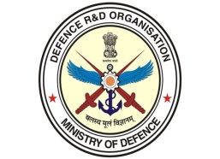
Defence Research and Development Organization – DRDO: Net work of Laboratories
Aeronautics
  ADE
  ADRDE
  CABS
  CEMILAC
  DARE
  GTRE
Armaments
  ARDE
  CFEES
  HEMRL
  TBRL
Naval Systems
  NMRL
  NPOL
  NSTL
Combat Engineering
  CVRDE
  VRDE
  R&DE (E)
  SASE
Electronics
  LRDE
  DRDL
  RCI
  ARL
  ANURAG
  ASEMIT
  CAIR
  DEAL
  MTRDC
Documents & Others
  DESIDOC
  SAG
  LASTEC
Material
  DMRL
  DMSRDE
  DLJ
  ACEM
  SSPL
Terrain
  SASE
  DTRL
Life Sciences
  DIBER
  DEBEL
  DFRL
  DIPAS
  DIPR
  DRDE
  DRL
  DIHAR
  INMAS
Notes:
ASemIT : Centre for Advanced Semiconductor Technology centre is located at Solid State Physics Laboratory (SSPL), Delhi.
Microwave Tube Research & Development Centre (MTRDC)
Defence Avionics Research Establishment (DARE)
Defence Materials and Stores Research and Development Establishment (DMSRDE) originated in 1929 as Inspectorate of General Stores in the Harness & Saddlery Factory, Cawnpore.
Advanced Centre for Energetic Materials (ACEM) is the latest addition to DRDO's capability for Composite Propellant processing. Situated near the holy city of Nasik,

Slide 17
Defence Public Sector Undertakings
HINDUSTAN AERONAUTICS LIMITED (HAL):
  20 Production Divisions, 11 R&D Centres and one Facility Management Division spread across the Country.
BHARAT ELECTRONICS LIMITED (BEL):
  has 9 Units across India.
BHARAT DYNAMICS LIMITED.(BDL)
  - 3 Units
BEML LIMITED (BEML)
  9 Units
MISHRA DHATU NIGAM LIMITED (MIDHANI)
MAZAGON DOCK SHIPBUILDERS LIMITED (MDL)
GARDEN REACH SHIPBULDERS AND ENGINEERS LIMITED (GRSE)
GOA SHIPYARD LIMITED (GSL)
HINDUSTAN SHIPYARD LIMITED (HSL)

Slide 18
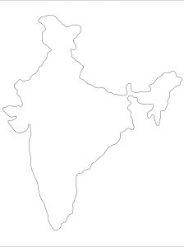
DIVISIONS OF HAL
BANGALORE COMPLEX
Aircraft Division
Engine Division
Indl. & Marine Gas Turbine Division
Overhaul Division
Aerospace Division
Foundry & Forge Division
Airport Services Centre
Central Materials and
Processes Laboratory
HELICOPTER COMPLEX
Helicopter Division, Bangalore
Helicopter MRO Division, Bangalore
Barrackpore Division, Barrackpore
Composite Mfg Division, Bangalore
Rotary Wing R&D Centre, Bangalore
*
Lucknow
Kanpur
*
Korwa
*
*
Barrackpore
MiG COMPLEX
Nasik
Aircraft Manufacturing Division, Nasik
Aircraft Overhaul Division, Nasik
Engine Division, Koraput
Sukhoi Engine Division, Koraput
Aircraft Upgrade R&D Centre, Nasik
Gas Turbine R&D Centre, Koraput
*
Koraput
*
ACCESSORIES COMPLEX
Hyderabad
*
Transport Aircraft Division, Kanpur
Accessories Division, Lucknow
Avionics Division, Hyderabad
Strategic Electronic Factory, Kasargod
Avionics Division, Korwa
Aircraft Systems and Equipment R&D Centre,
Lucknow & Korwa
Strategic Electronics R&D Centre, Hyderabad
Transport Aircraft R&D Centre, Kanpur
Bangalore
*
DESIGN COMPLEX
Kasargod
*
Aircraft R&D Centre , Bangalore
Mission & Combat System R&D Centre , Bangalore
Aero Engine R&D Centre, Bangalore

Slide 19
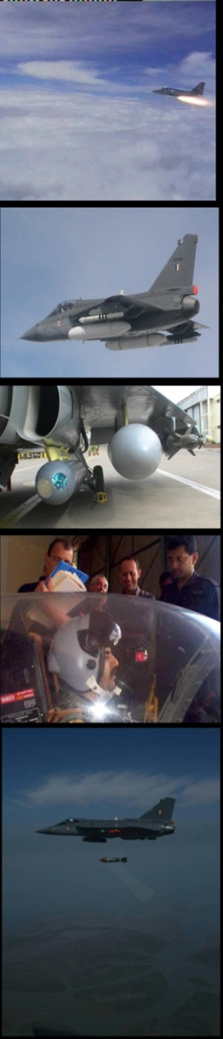
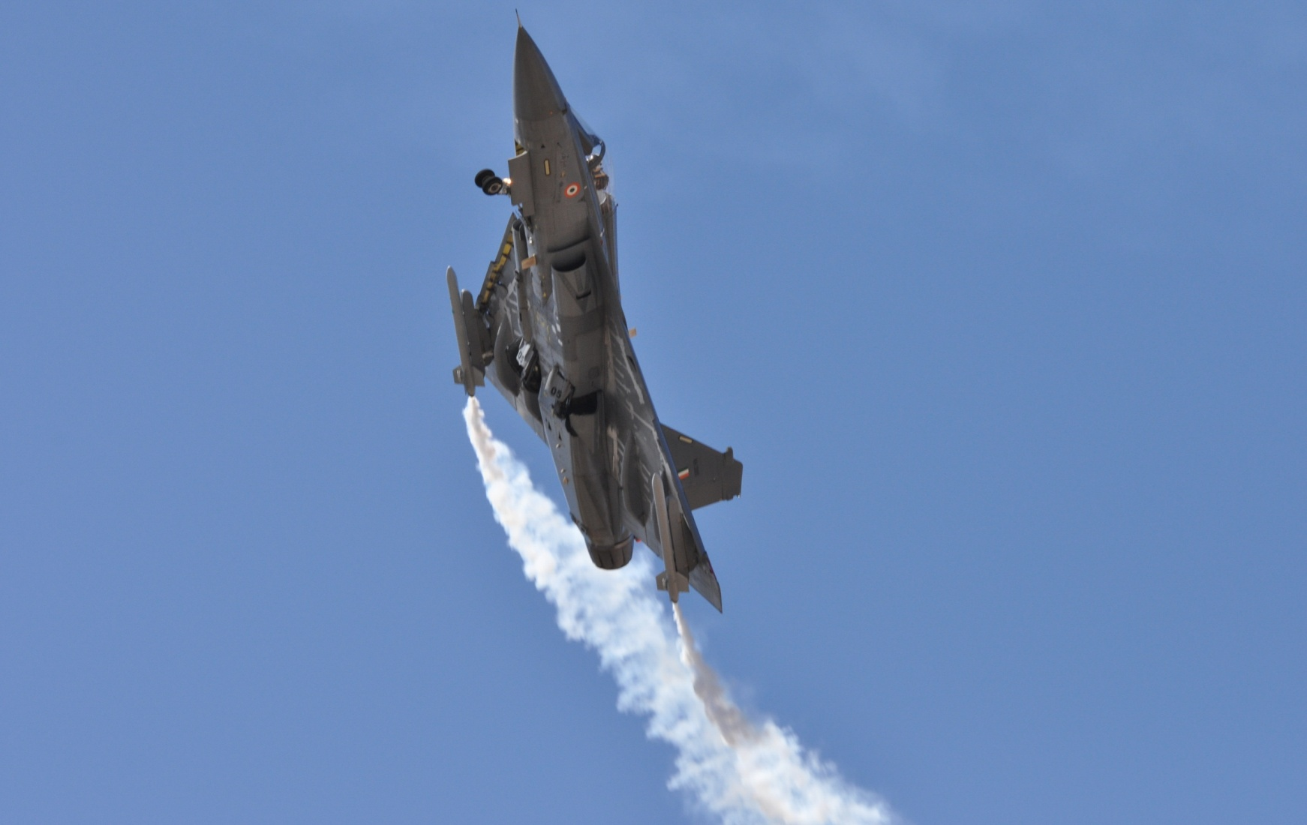
Light Combat Aircraft - Tejas

Slide 20
LCA – A National Effort

Slide 21
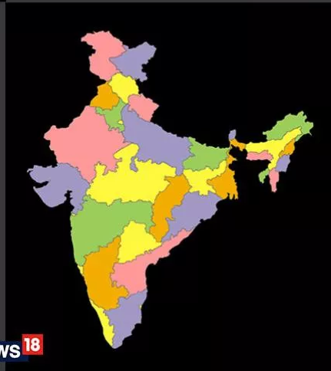
HAL & Aerospace Ecosystem Development
Northern Zone 173
12
2
41
41
2
77
1
22
2
73
7
Overall Vendor Base
2412
Western Zone 526
493
18
Eastern Zone 94
334
2
Value of indigenous sourcing ~ 1195 Crs
1119
151
15
Southern Zone 1619

Slide 22
Certification Systems – As Control Mechanism
The Aerospace
‘ICOP’ (Industry Controlled Other Party) scheme
The ‘traditional’ scheme
3rd party
Certification
for ISO 9001
2nd party audits
Approval
and
oversight
Accreditation Bodies
Industry
Accreditation Bodies
Industry
accreditation
Surveillance
based
on risk
analysis
&
product audit
Certification Bodies
Suppliers
Certification Bodies
certification
Auditors
Suppliers
Suppliers
Other party
Certification
for 9100/9110/9120

Slide 23
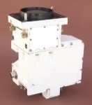
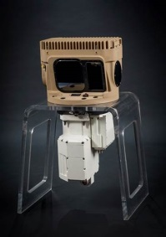
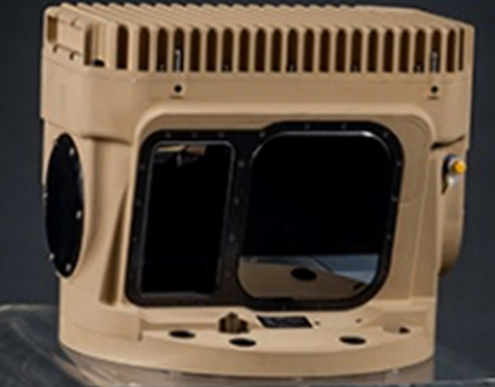
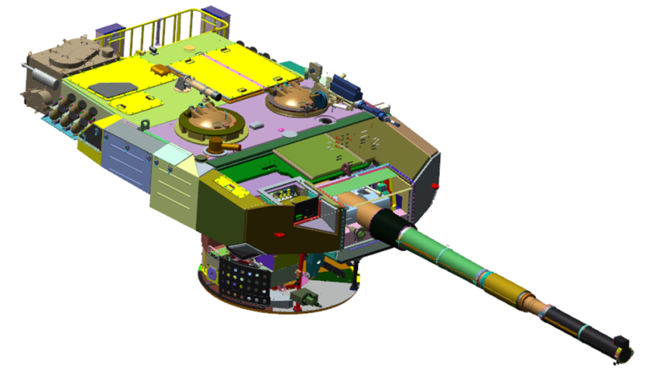
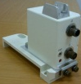
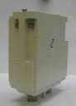
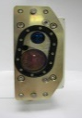
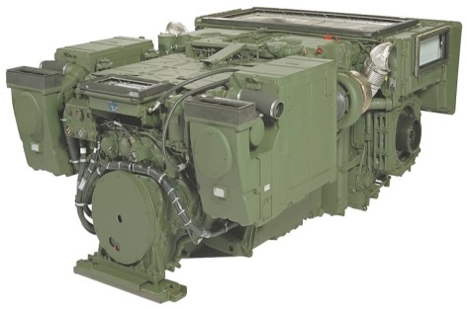
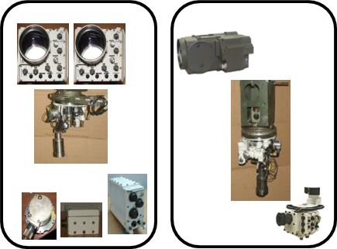
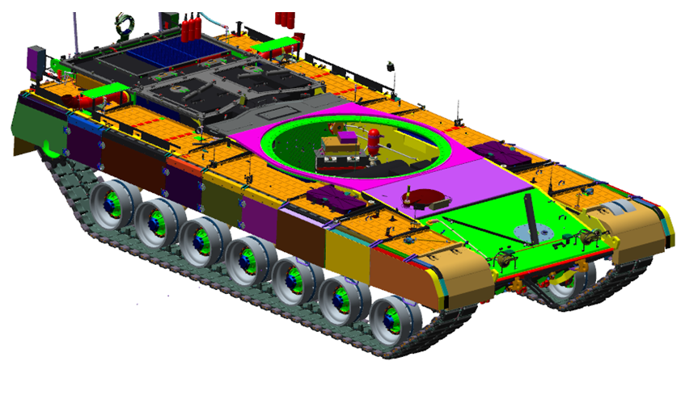
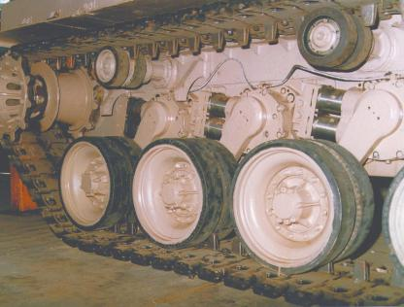
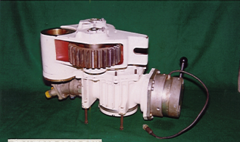
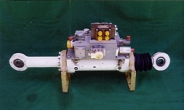
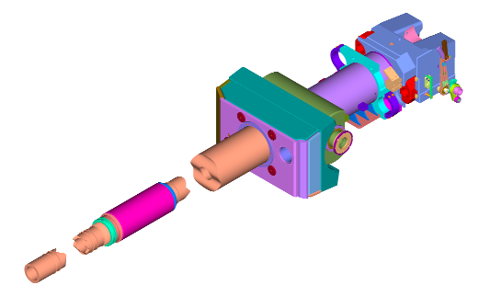
MAJOR SYSTEMS OF ARMOURED FIGHTING VEHICLE
Powerpack
– Engine & Transmission
Fire Control System
Thermal Imaging System
Running Gear System
- Suspension & Track
More than 200 Sub-Systems in AFV
Hull and Wiring Harness Integrate the Systems
Armament
Gun Control System

Slide 24
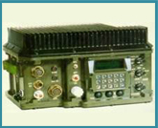
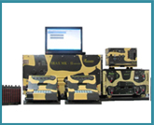
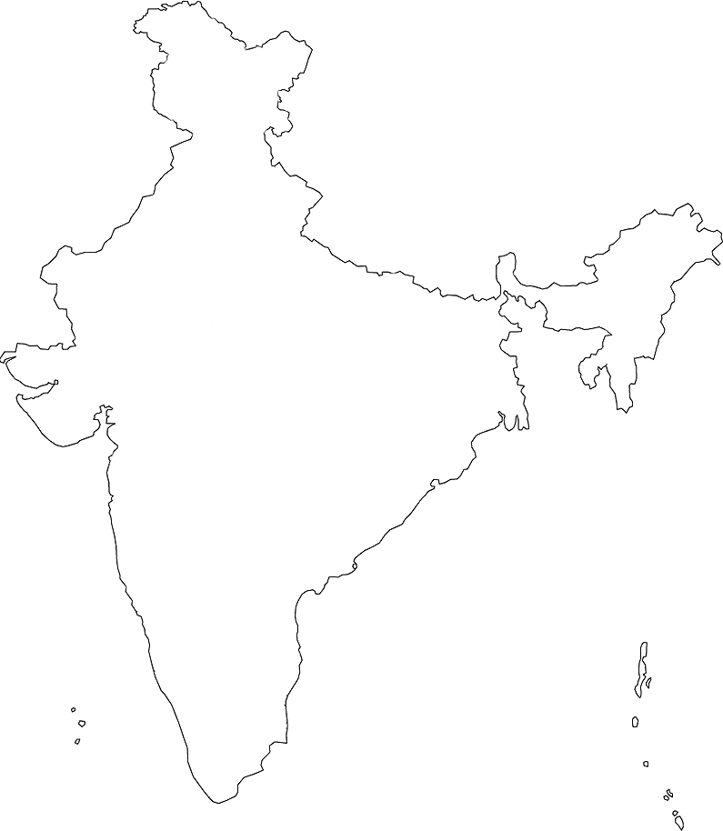
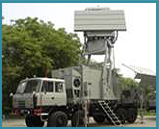
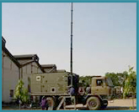
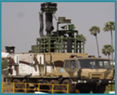
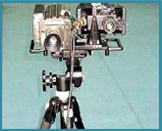
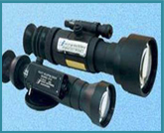
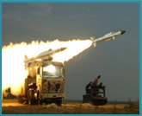
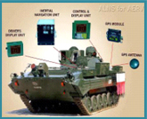
BEL Manufacturing Network
Panchkula (1985)
Kotdwara (1986)
Tactical Communication Equipment
Portable Radar
Defence Communication Equipment & Telecom Products
Ghaziabad (1974)
Radar
Network Centric Systems
Satcom & Cellular Communication
Antenna
Navi Mumbai (1986)
Shelters
Masts
Hyderabad (1986)
Pune (1979) BELOP
Electronic Warfare Equipment
Batteries
Electro Optics
Laser Products
Machilipatnam (1983)
Electro Optic Equipment
Bangalore (1954)
Military Communication
Electronic Warfare & Avionics
Military Radar
Missile Systems
Naval Systems (Sonars & Communication Systems)
Naval Systems (Radar & Fire Control Systems )
Export Manufacturing
Components
Chennai (1985)
Tank Electronics Land Navigation Systems
Fire Control Systems
Gun Upgrades.

Slide 25
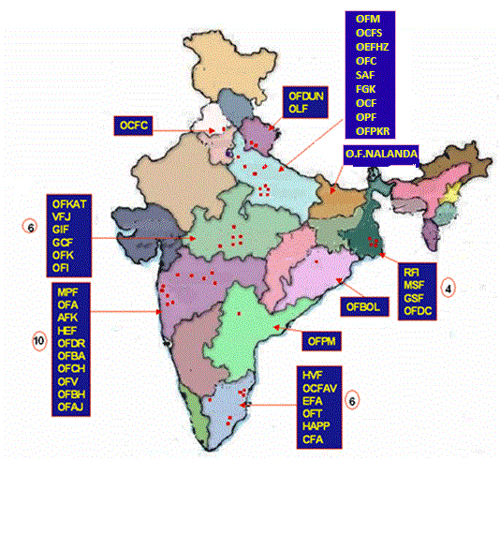
Ordnance Factories
Ordnance Factory Bhandara (OFBA)
Ordnance Factory Bhusawal (OFBH)
Ordnance Factory Bolangir (OFBOL)
Ordnance Factory Kanpur (OFC)
Ordnance Factory Chandrapur (OFCH)
Ordnance Factory Dumdum (OFDC)
Ordnance Factory Dehu Road (OFDR)
Ordnance Factory Dehradun (OFDUN)
Ordnance Factory Itarsi (OFI)
Ordnance Factory Khamaria (OFK)
Ordnance Factory Katni (OFKAT)
Ordnance Factory Muradnagar (OFM)
Ordnance Factory Project Nalanda (OFN)
Ordnance Factory Project Korwa (OFPKR)
Ordnance Factory Project Medak (OFPM)
Ordnance Factory Tiruchirapalli (OFT)
Ordnance Factory Varangaon (OFV)
Opto Electronics Factory (OLF)
Ordnance Parachute Factory (OPF)
Rifle Factory Ishapore (RFI)
Small Arms Factory (SAF)
Vehicle Factory Jabalpur (VFJ)
Ammunition Factory Khadki (AFK)
Cordite Factory Aruvankadu (CFA)
Engine Factory Avadi (EFA)
Field Gun Factory Kanpur (FGK)
Gun Carriage Factory (GCF)
Grey Iron Foundry (GIF)
Gun and Shell Factory (GSF)
Heavy Alloy Penetrator Project (HAPP)
High Explosive Factory (HEF)
Heavy Vehicle Factory (HVF)
Machine Tool Prototype Factory (MPF)
Metal and Steel Factory (MSF)
Ordnance Clothing Factory Avadi (OCFAV)
Ordnance Cable Factory Chandigarh (OCFC)
Ordnance Clothing Factory Shahjahanpur (OCFS)
Ordnance Equipment Factory Kanpur (OEFC)
Ordnance Equipment Factory Hazratpur (OEFHZ)
Ordnance Factory Ambernath (OFA)
Ordnance Factory Ambajhari (OFAJ)

Slide 26

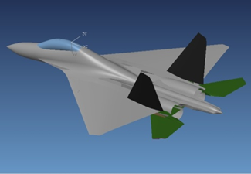





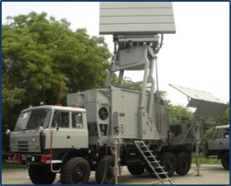

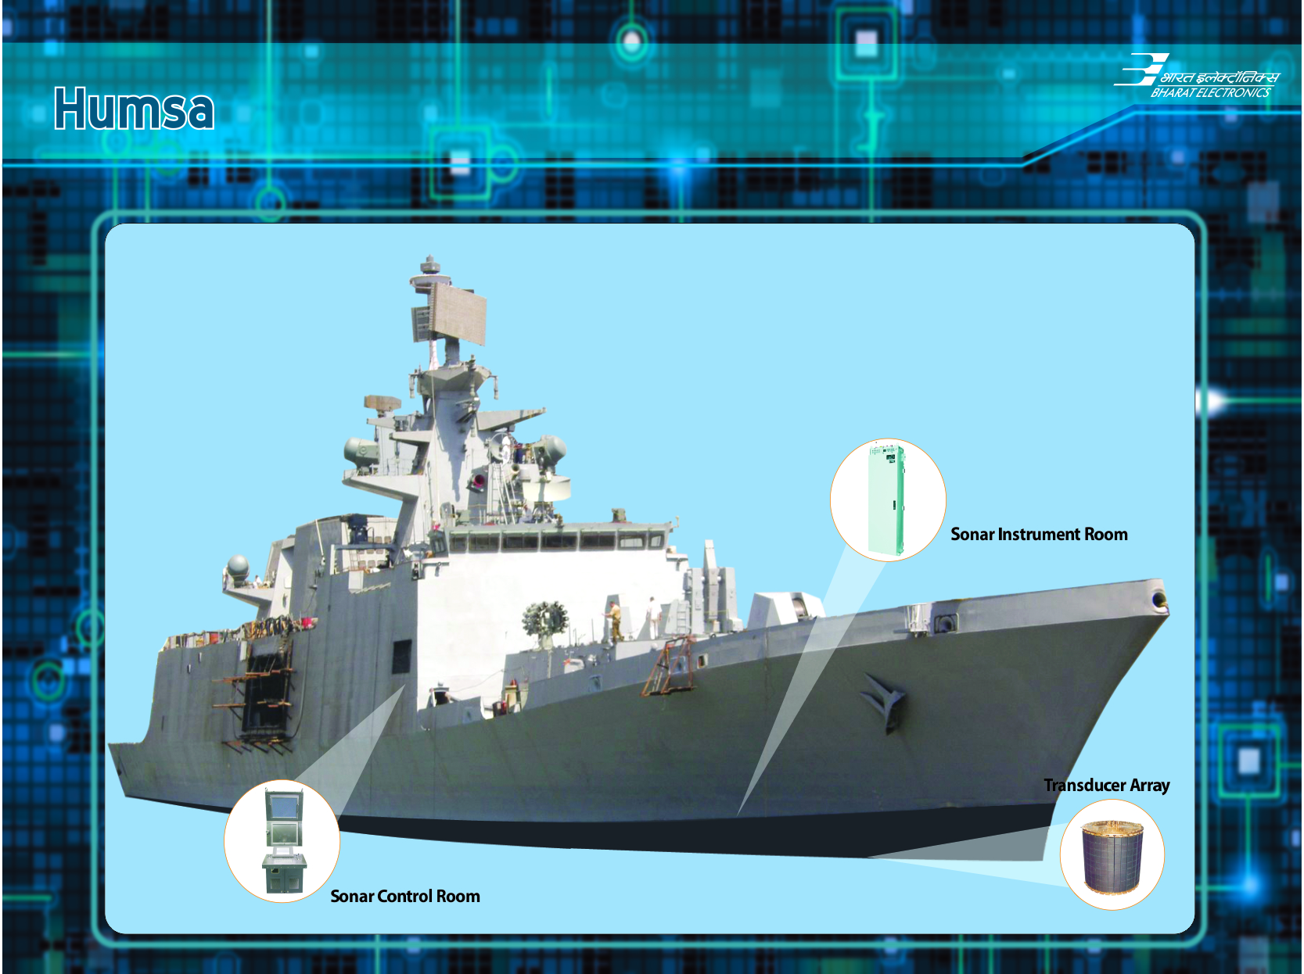





Technology Domains – Sample List
Advanced Electronics
Air Platforms
Autonomy
Biomedical
C4I
Counter-IED
Cyber
Electronic Warfare
Energy & Power Technologies
Ground & Sea Platforms
Human Systems
Materials & Manufacturing Processes
Sensors
Space
Weapons Technologies

Slide 27
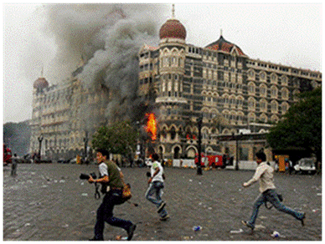
Urban Terrorism
Primary threat from various religious extremists and separatists.
Prior attack methods include:
  Vehicle bombs / IEDs
  Kidnappings
  Murder
  Biological weapons
Prior attacks include:
  Multiple attacks in Mumbai, India
  Bali nightclub bombing
  Anthrax attack on Japanese subway
In 2008, terrorists attacked multiple targets in Mumbai, India including the Taj Mahal Hotel
27
Notes:
Terrorist attacks in this region demonstrate a broad spectrum of tactics. These include kidnappings, suicide bombings, and even chemical attacks. Aleph, formerly known as Aum Shinrikyo, attacked the Tokyo subway with Sarin nerve gas and cyanide in 1995. Abu Sayyaf, a Philippine group seeking to create a radical Muslim state, targets Americans for kidnapping.
In 2001, Singaporean officials foiled a plot to attack US military forces and western diplomatic missions.
The group, Jamaah Islamiya, seeks to create a radical Muslim state across South East Asia. In 2002, 2005, and 2009 it conducted bombings in Bali and Jakarta, Indonesia to kill western tourists.

Slide 28
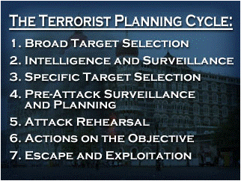
Terrorist Planning Cycle Overview
Be alert to signs of intelligence gathering, surveillance, collecting materials for attack, and rehearsals:
  Taking photos or videos of potential targets
  Writing notes or sketching
  Showing abnormal attention to details of security measures
  Using false identification
  Paying cash for items normally bought on credit
  Purchasing large quantities of items such as chemicals or cell phones
Terrorists prepare for and conduct attacks through predictable steps
.
28
Notes:
Terrorists prepare and conduct attacks through predictable steps. Through vigilance, you may be able to recognize preparations for an attack before it is executed. Be alert to unusual behavior that may indicate intelligence gathering, surveillance, collecting materials for attack, dry runs, and rehearsals.
For example:
Taking photos or videos of potential targets
Writing notes or sketching details about a possible target
Showing abnormal attention to details of routine activities and security measures
Using false identification
Paying cash for items normally bought on credit
Purchasing large quantities of items that could be used as part of an attack (e.g., chemicals or cell phones)
If you see something unusual, report it immediately to security officials for further investigation. Make a note of the individual's description and activities, the time of day, and equipment being used.
On the following screens, the planning and execution of the November 2008 attacks in Mumbai, India, illustrate this process. Consider how a vigilant person might have recognized indications of a threat or how you would respond in a similar situation.

Slide 29
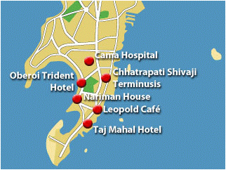
Terrorist Planning Cycle – Phases 1 & 2
Phase 1: Broad Target Selection
  Terrorists collect information on numerous targets
  Evaluate target potential in terms of symbolic value, casualties, infrastructure criticality, or public attention
Phase 2: Intelligence Gathering and Surveillance
  Targets able to meet attack objectives are selected for additional surveillance
  Terrorists seek information on guard forces, physical layout, personnel routines, and standard operating procedures
Map of the Mumbai Peninsula identifying the most prominent targets from the 2008 attacks
29
Notes:
Phase 1: Broad Target Selection.
During broad target selection, terrorists collect information on numerous targets to evaluate their potential in terms of symbolic value, casualties, infrastructure criticality, or public attention.
Through acts of terror Lashkar-e-Taiba (LeT) seeks to end Indian administration over parts of Kashmir. Beginning in 2005, LeT identified potential targets in Mumbai including international hotels, restaurants, public transportation nodes, public squares and parks, entertainment establishments, and at least one foreign embassy.
Phase 2: Intelligence and Surveillance.
Vulnerable targets able to meet attack objectives are selected for additional intelligence gathering and surveillance. This effort may occur quickly or over years depending upon the target and planning information needed. Terrorists seek to gather detailed information on guard forces, physical layout, personnel routines, and standard operating procedures.
More than two years prior to the attack, LeT dispatched multiple operatives to Mumbai to gather intelligence on potential targets. Operatives used video and photographs to capture preliminary information on target layouts, security measures, and population demographics.

Slide 30
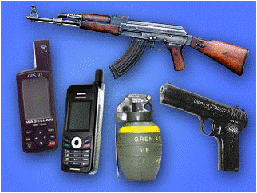
Terrorist Planning Cycle – Phases 3 & 4
Phase 3: Specific Target Selection
  Specific targets identified based on anticipated effects, publicity, consistency with objectives, and costs versus benefits
Phase 4: Pre-attack Surveillance and Planning
  Terrorists may conduct additional surveillance to confirm previous information and gain additional details
  Terrorists select attack method, obtain weapons and equipment, recruit specialized operatives, and design escape routes
The equipment used by terrorist teams during the Mumbai attacks
30
Notes:
Phase 3: Specific Target Selection.
Specific targets are then identified for attack based on anticipated effects, publicity, consistency with overall objectives, and costs versus benefits of the attack.
LeT chose targets to maximize casualties, attract media coverage, and further its anti-western and anti-Semitic agenda. Among its targets was the busiest railway station in India, a popular restaurant and bar frequented by foreigners and affluent Indians, two hotels popular with foreign officials and Western tourists, and a hostel owned and operated by an orthodox Jewish organization.
Phase 4: Pre-Attack Surveillance and Planning.
Terrorists may conduct additional surveillance to confirm previous information and gain additional details. During this stage, terrorists will select the method of attack, obtain weapons and equipment, recruit specialized operatives, and design escape routes.
LeT operatives, sometimes disguised as foreign businessmen or a honeymooning couple, conducted additional reconnaissance of targets. One operative videotaped the Taj Mahal Hotel conference center and ballroom and acquired schedules of upcoming events. Operatives also identified an area on the coast where terrorist teams sailing from Pakistan could land and be deployed.

Slide 31
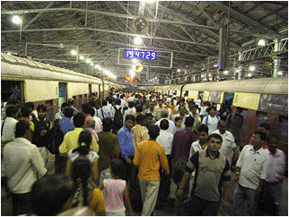
Terrorist Planning Cycle – Phases 5 & 6
Phase 5: Rehearsals
  Terrorists rehearse the attack scenario to confirm planning assumptions, enhance tactics, and practice escape routes
  May also trigger an incident at the target site to test response actions
Phase 6: Actions on the Objective
  Terrorists execute attacks when conditions favor success with the lowest risk
  Factors include surprise, time and place, use of diversionary tactics, and ways to impede response measures
Chhatrapati Shivaji Terminusis is the busiest railway station in India
31
Notes:
Phase 5: Rehearsals.
Terrorists often rehearse the attack scenario to confirm planning assumptions, enhance tactics, and practice escape routes. They may also trigger an incident at the target site to test the reaction of security personnel and first responders.
Operatives in Mumbai continued surveillance and videotaped and timed routes security forces would use during response. Portable GPS units were pre-programmed with coordinates of targets and escape routes. In Pakistan, LeT selected and trained 10 operatives in small arms and explosives. Styrofoam mockups and Google Earth were used to familiarize operatives with targets.
Phase 6: Actions on the Objective.
Terrorists choose to execute attacks when conditions favor success with the lowest risk. Factors they consider include surprise, choice of time and place, use of diversionary tactics, and ways to impede response measures.
On 23 November 2008, LeT hijacked an Indian fishing vessel and sailed to Mumbai. In Mumbai, the terrorists split into teams and distributed weapons, GPS units, and cell phones that would be used by handlers. Using automatic weapons and IEDs the terrorists attacked more than ten targets killing 156 and wounding hundreds more. The attacks took place when the terrorists believed Indian and foreign government officials were using the hotels that were targeted.

Slide 32
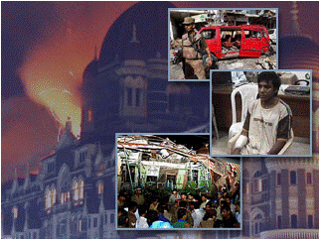
Terrorist Planning Cycle – Phase 7
Phase 7: Escape and Exploitation
  Unless an operation is a suicide attack, escape routes are carefully planned and rehearsed
  Terrorists may exploit successful attacks by releasing pre-developed statements to the press
Ajmal Kasab was the only terrorist captured alive during the 2008 Mumbai attacks
32
Notes:
Phase 7: Escape and Exploitation.
Unless an operation is a suicide attack, escape routes are carefully planned and rehearsed. Terrorists may exploit successful attacks by releasing pre-developed statements to the press.
Multiple terrorist teams used pre-programmed GPS units to flee one target and attack another. If captured, they were trained to resist interrogation and torture. While escape from India was unlikely, in the event it was possible, a pre-programmed water route back to Pakistan was loaded into each GPS unit. LeT commanders directed the operation with cell phones from safe locations outside of India and were never in danger of being caught.
LeT sent an email message to news organizations claiming responsibility for the attack using the name Deccan Mujahideen.

Slide 33
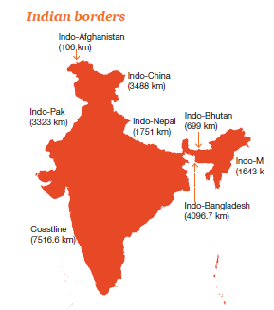
Border Management

Slide 35

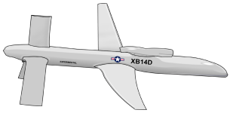

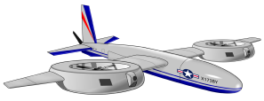



Network Centric Information Infrastructure
Synchronous Orbit Relay Satellite
Optical
Link
Intel Data /
CONUS Commands
Communications Node with Multi-Beam Antenna and Data Switching Capability
Optical
Links
Broad-Area Surveillance Radar UAV
Airborne Command Center
Covert Uplink
Multiple RF
Circuits
Forward deployed data to everyone
Low-Altitude
UAVs
Ground/Maritime Sensors
Forces
Attributes:
All entities: people, platforms, sensors, weapons are interconnected
All entities can pull data in real time
All entities have access (as appropriate) to relevant data at all times
Notes:
The basic issue in the design of a communications infrastructure for a counter-terrorism information system is that of providing linkage of the various components of such a system given the constraints of frequency spectrum, radio wave propagation, flexibility of interconnections, security of transmissions, covertness of ground terminal up-links and costs.
The network structure outlined in the graphic provides one solution to these problems. Other designs are also possible as well.
The basic premise of the system is to employ a form of packet network such that communications can be established between any of the terminals if necessary. The capacity of the individual links in the network varies by large factors depending on the demand. This means that if large data packages are requested to be sent over low capacity links, considerable time will be required for transmission. However, for most transmissions, such delays will not be encountered.
Beginning at the highest level in the network, space based communications repeaters with a global span are employed. These nodes themselves would be interconnected by very high capacity millimeter wave or optical links. This high level network in space would then be connected to ground and large high altitude airborne based terminals also by means of either millimeter wave or optical links. Initially, current satellites could be employed until such a backbone space infrastructure is built.
The high altitude air based broad area radar sensors of the information system will initially produce significantly high transmission rates (perhaps as much as 300 million bits per second). However more advanced high altitude sensors will be able to reduce this rate significantly through the use of change detection data processing and other techniques. At least an order of magnitude reduction should be possible. This will then allow a number of high altitude sensors to transmit data simultaneously to central data processing and analysis centers.
(continued)

Slide 36
Surveillance Sensors
Sensor Tier | Role | New Technology
1. Space | Global reference data Coherent change detection | Automated urban feature extraction Sensor interoperability across tiers
2. High-Altitude Surveillance Radar | Detecting fixed and moving targets Cueing lower-tier sensors | Foliage and building penetration People detection with differential imaging radar Precision real-time tracking and EO/IR imaging techniques of moving objects
3. Medium-Altitude Optical Imagers | Identification of fixed and moving targets Tracking targets including people | Airborne platforms with long-range and endurance
4. Netted Tactical Sensor Arrays | Determining terrorist objectives with persistent close-up surveillance Provide tactical commander “a look over the next hill” | Ultra low-power sensors and data processors Energy for long-term power Sensor Network Fusion

Slide 37
Questions?

